Slide 1

ASIC Implementation of Motion Estimator in 32/28nm CMOS Under Dr Mahmoodi
Chirag Adiga

Slide 2
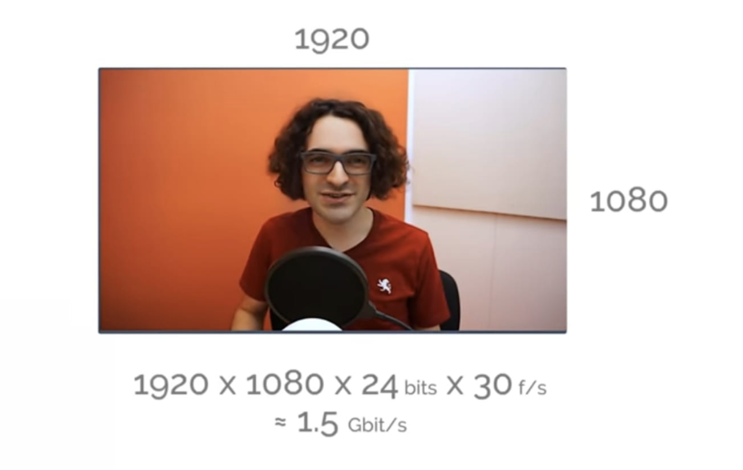
Why the need for Compression?

Slide 3
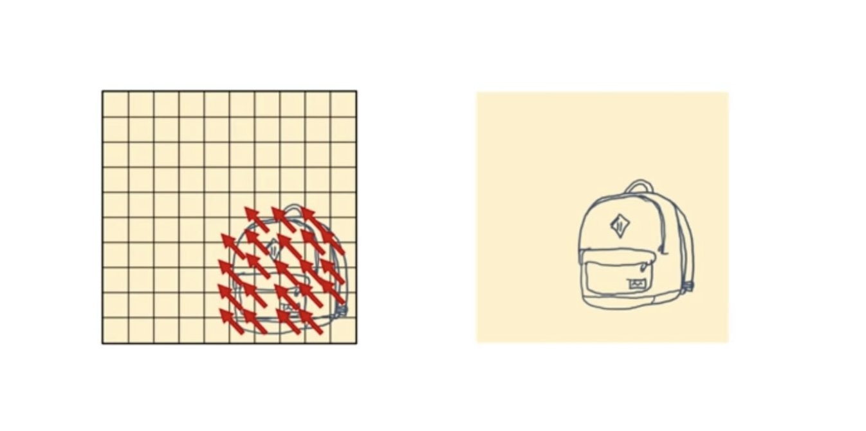
Motion estimation. What is it?
https://youtu.be/QoZ8pccsYo4
Process of determining motion vectors that describe the transformation from one 2D image to another; usually from adjacent frames in a video sequence
The task is to detect blocks of video data in successive frames that are related only through a translation

Slide 4
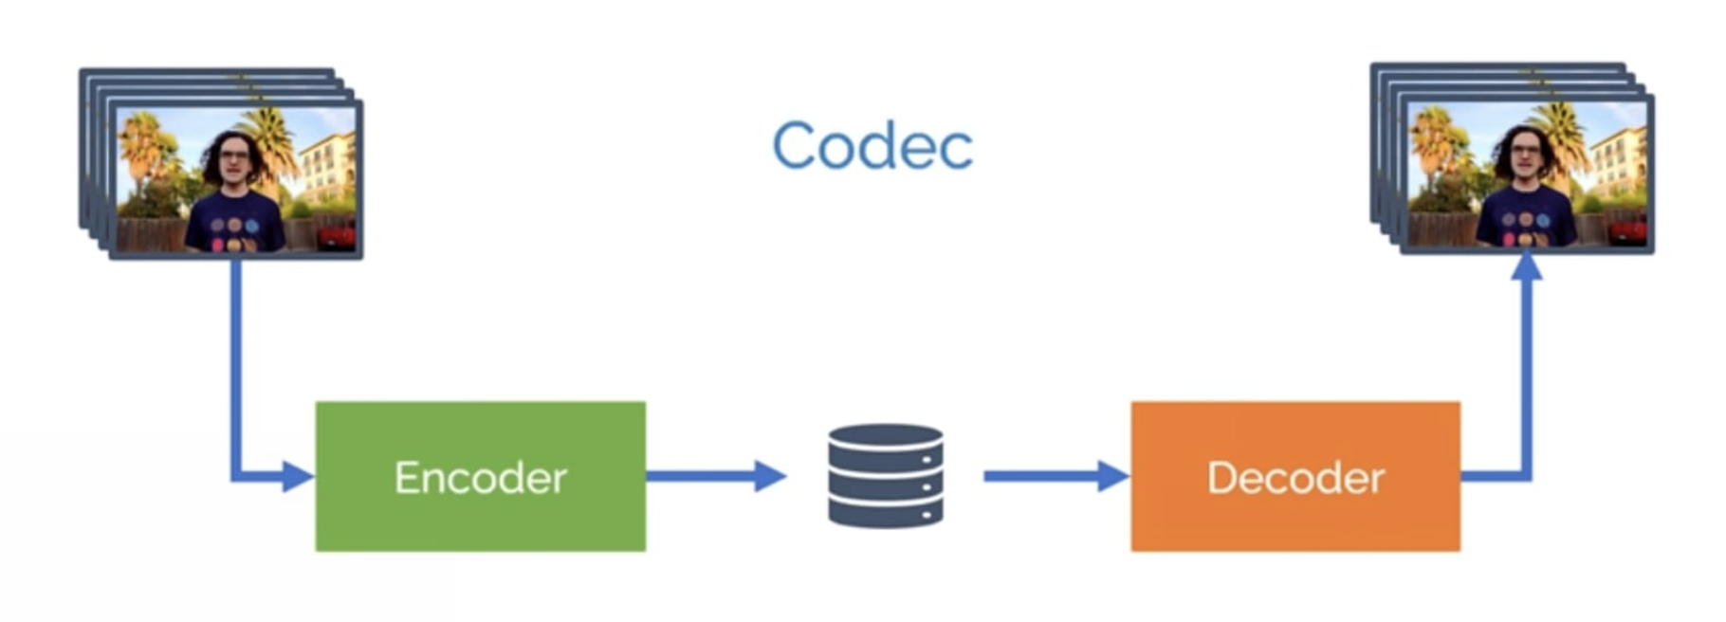
Mainstream Codecs
H.264 MPEG-4 (AVC)
H.265 HEVC
VP9

Slide 5
Goals
To design the motion estimator from HDL to GDS in the 32/28nm CMOS technology with given design specifications.
Operate at the speed of 15 frames per second.
Reference block of 16x16 pixels.
Search window of 32x32 pixels.
Minimize the total area and energy consumed

Slide 6
Introduction
Motion Vectors describing the motion of a block in adjacent frames are to be found out.
The Luminance of a Greyscale image, which is the intensity of the pixel is used to perform Motion Estimation
All pixels are 8bit grayscale coded. i.e value varies from 0-255
There are 4096 reference blocks.

Slide 7
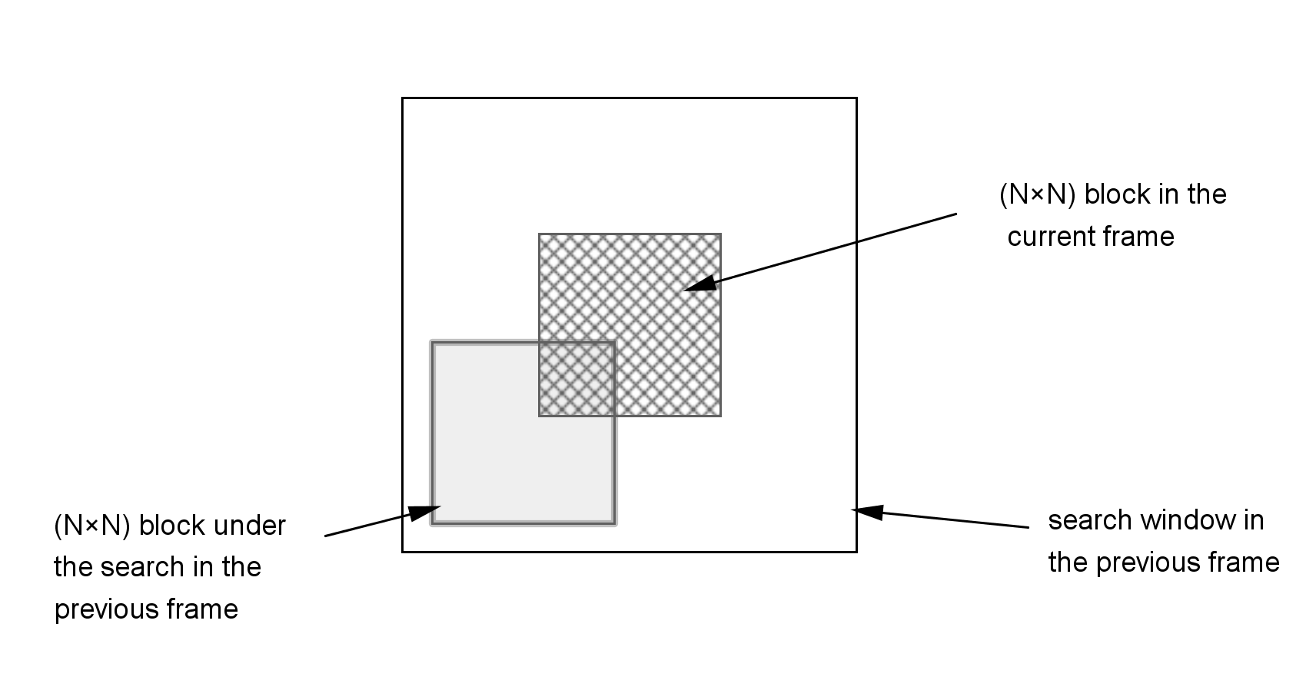
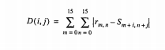
Block matching algorithm (BMA)
A Block Matching Algorithm is a way of locating matching macroblocks in a sequence of video frames for the purposes of Motion Estimation
Motion vector found when minimum distortion is found.

Slide 8
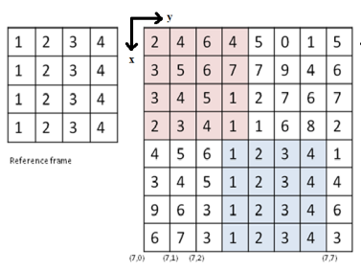
Reference Block on Search Frame
Fig.4. Ref & Search image matching structure
M. Sayed, W. Badawy, and G. Jullien, “Towards an H.264/AVC HW/SW Integrated solution: An Efficient VBSME Architecture,” in IEEE Trans CAS II Express Briefs, Vol. 55, No. 9, Sept. 2008, pp. 912-916 [7]

Slide 9
Fig.3. Motion Estimator Module interconnection
M. Sayed, W. Badawy, and G. Jullien, “Towards an H.264/AVC HW/SW Integrated solution: An Efficient VBSME Architecture,” in IEEE Trans CAS II Express Briefs, Vol. 55, No. 9, Sept. 2008, pp. 912-916 [7]

Slide 10
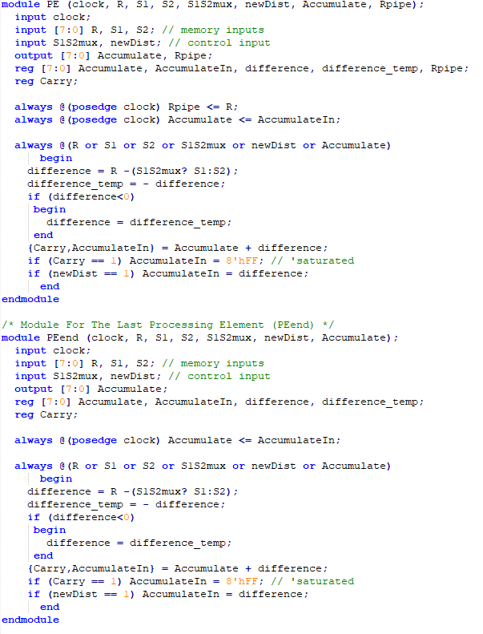
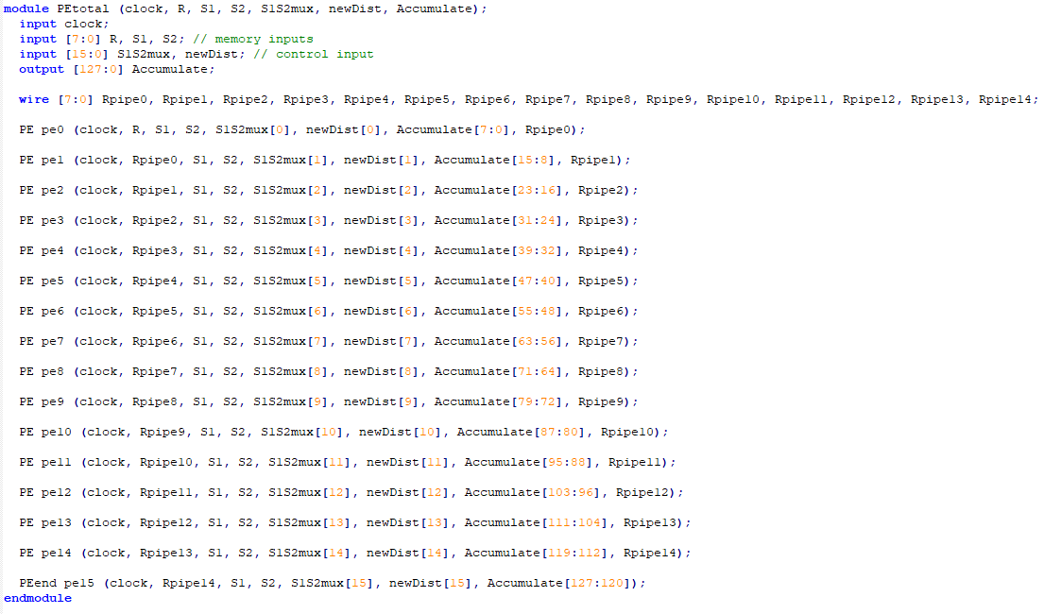
Processing Element
Design

Slide 11
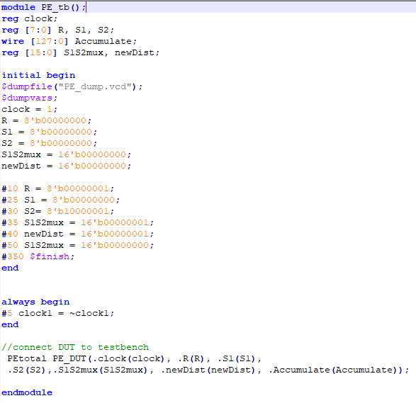
Testbench

Slide 12
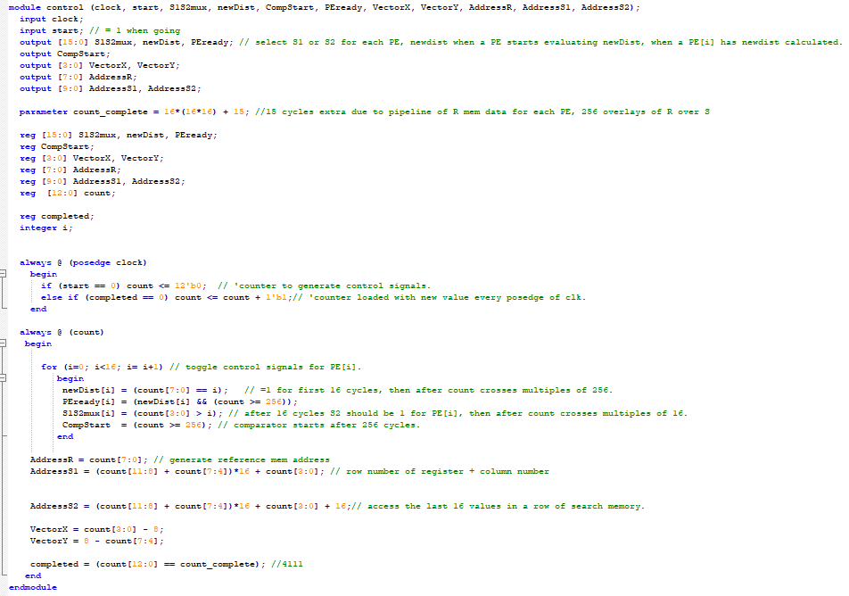
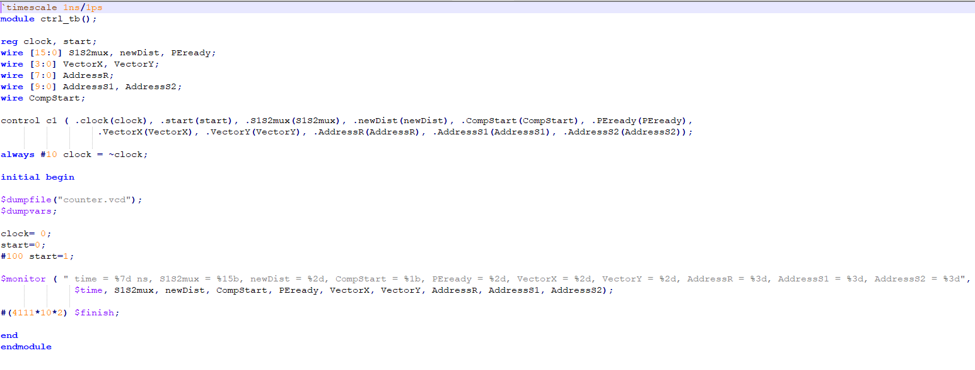
Control Unit
Design
Testbench

Slide 13
RTL Synthesized

Slide 14
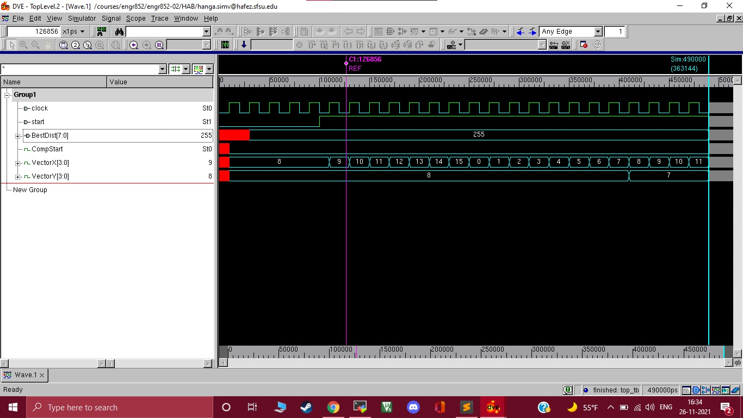
Overall outcome

Slide 15
WORKING OF THE PE MODULE

Slide 16
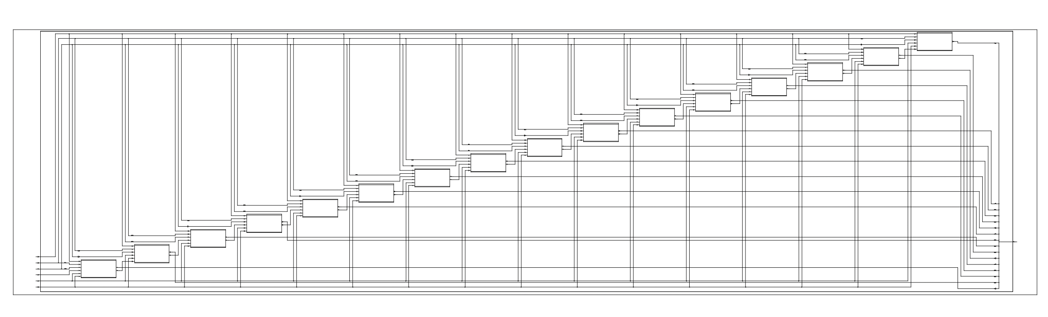
Processing Unit
16 parallel Processing elements schematic.

Slide 17
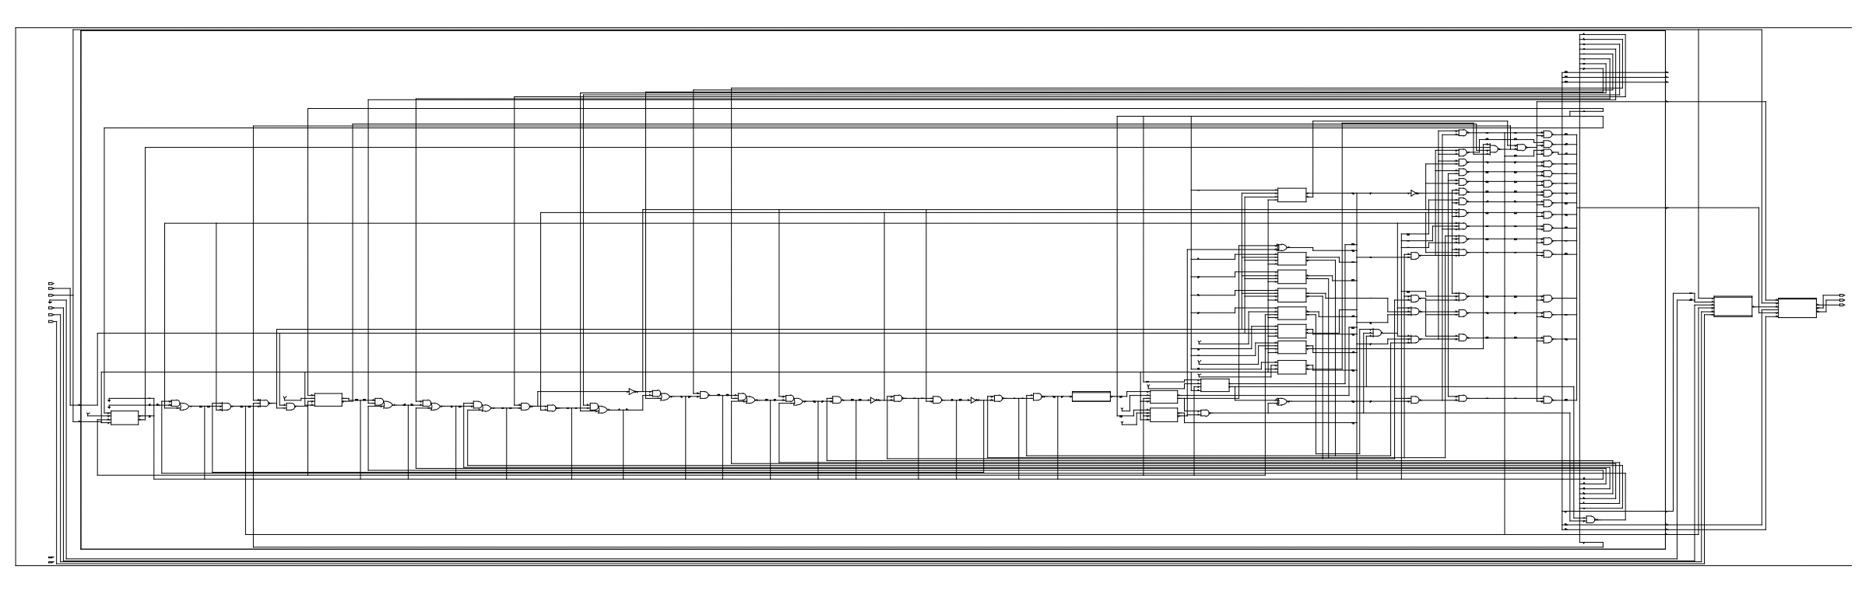
Control unit
Control element

Slide 18
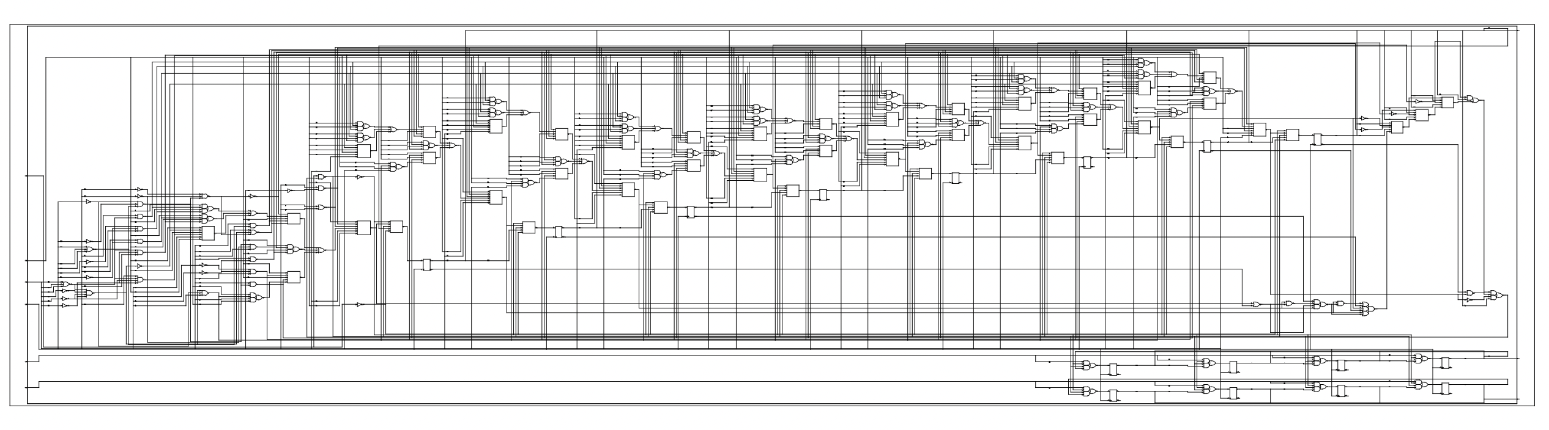
Comparator unit
The circuitry generated for comparator

Slide 19
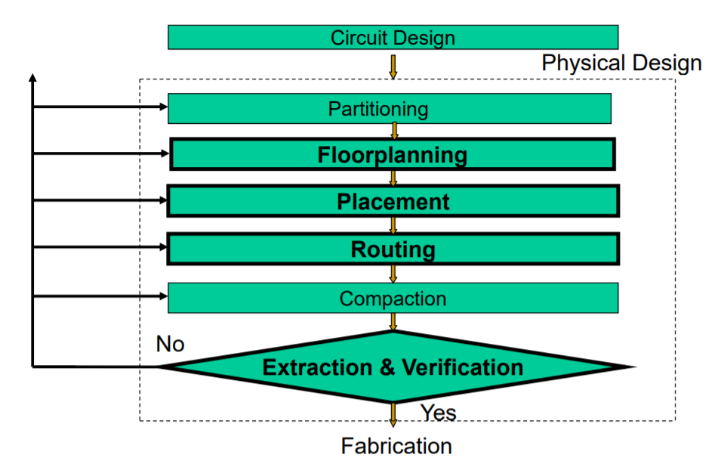
Physical Design
Figure 12. Physical Design Flow

Slide 20
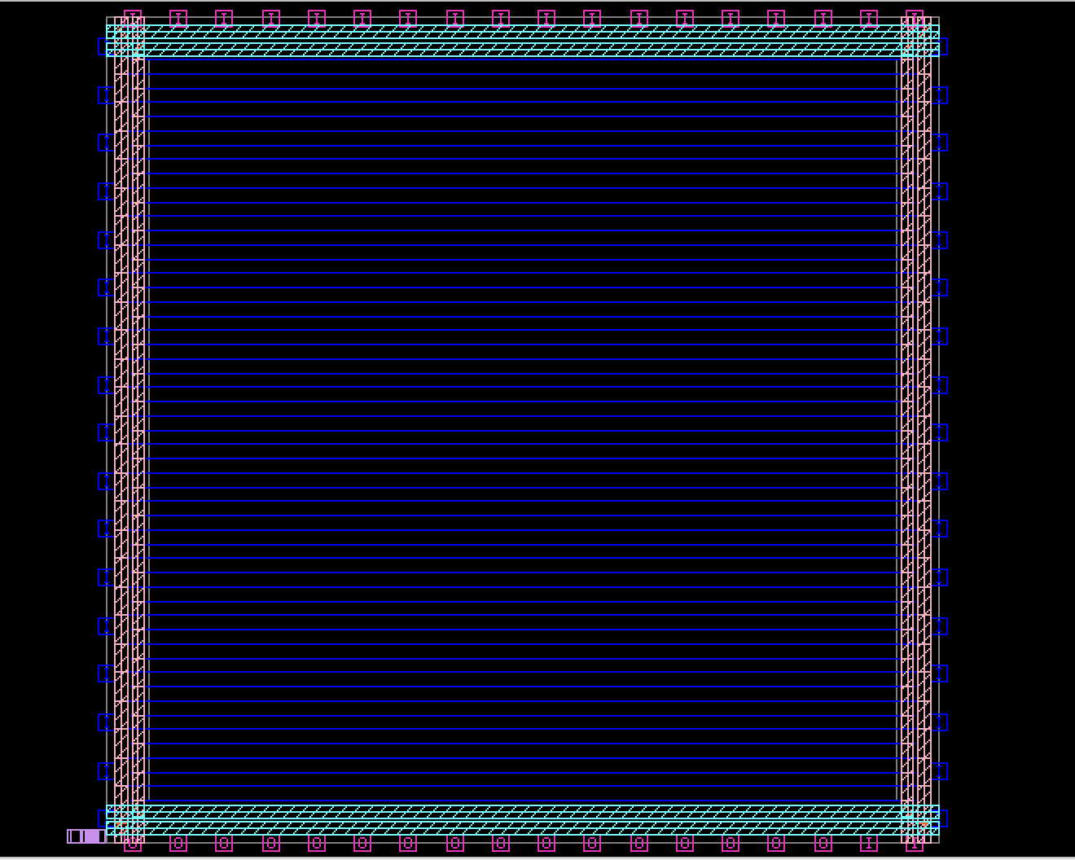
Floor planning
estimator.v which was the netlist generated had all the connections of the blocks
Blocks are generated through scripts
17 i/o ports are present on each y axis and 18 i/o ports are present on each x axis amounting to a total of 70 I/O pins on the final GDS 2 die
VDD and VSS and the power lines
required for the blocks and the preplaced
cells
Floorplan with power nets

Slide 21
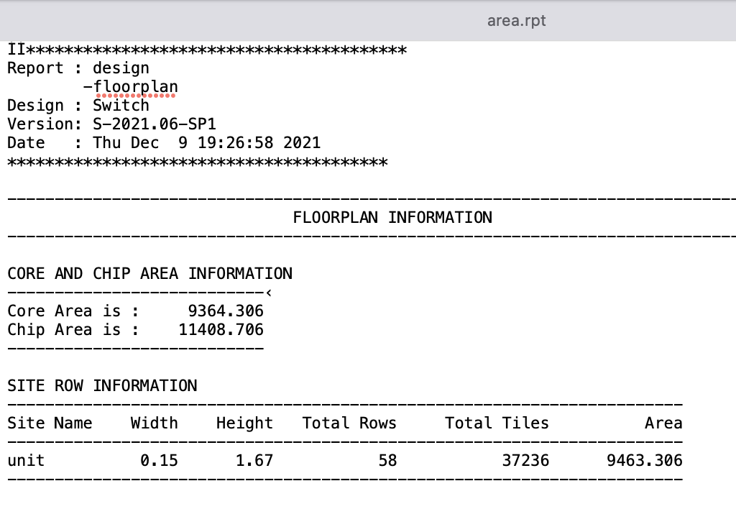

Slide 22
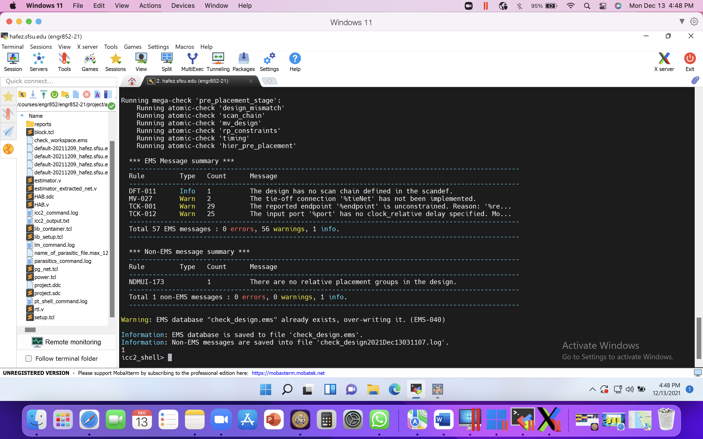
Placement
Pre-placement check

Slide 23
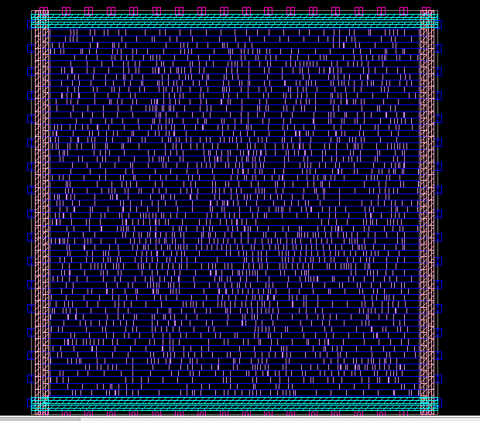
Placement
Cell placement before CTS

Slide 24
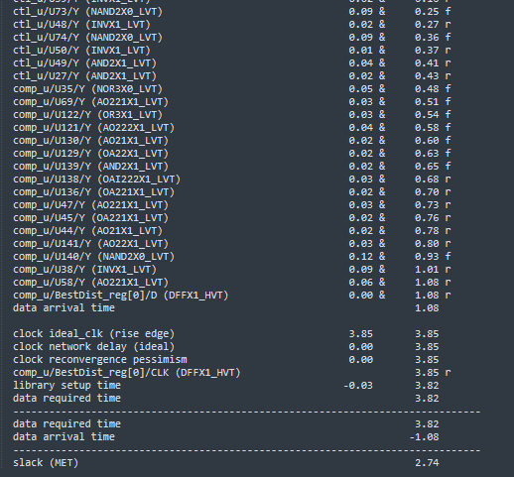
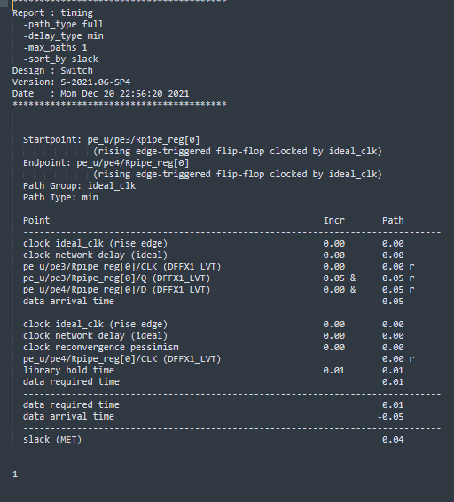
Post placement timing
Maximum timing report
Minimum timing report

Slide 25
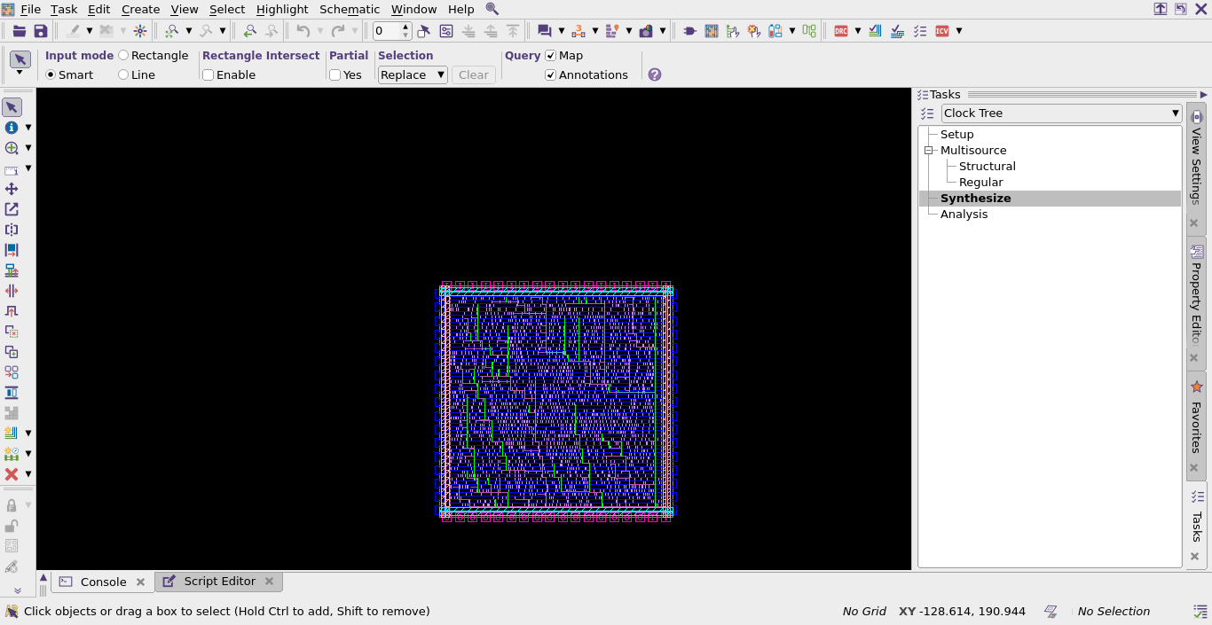
CTS
CTS is a process of even distribution of clock to all sequential elements in the design
Inserts logic delay (buffers) depending on the clock skew
Delay in the Launch side will prompt the tool to Better the hold time
Delay on Capture side promote a Better setup time
Clock insertion

Slide 26
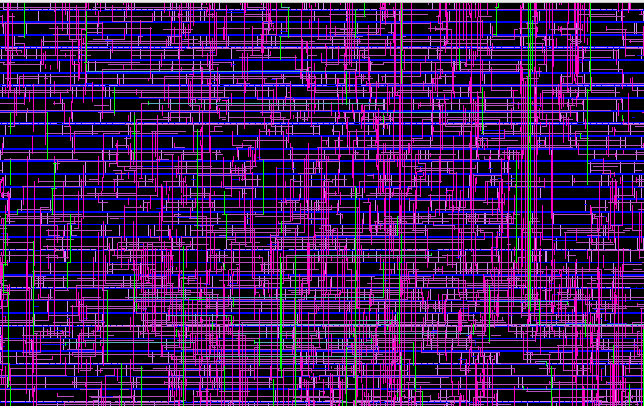
Routing
Routing connects all the blocks and cells together according to the requirement in the chip

Slide 27
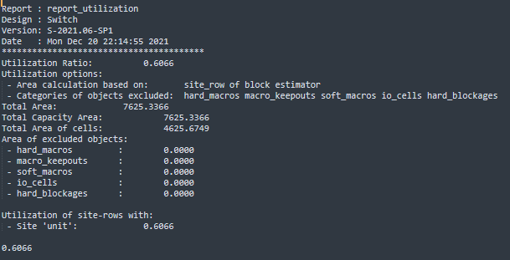
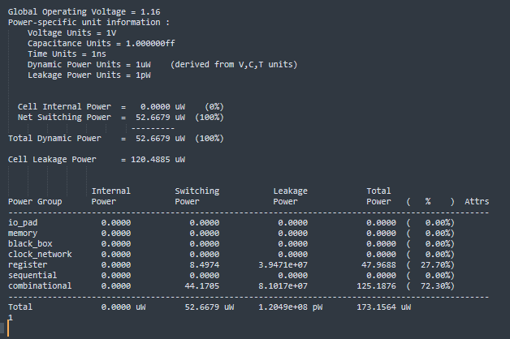
Reports
Utilization report
Power report

Slide 28
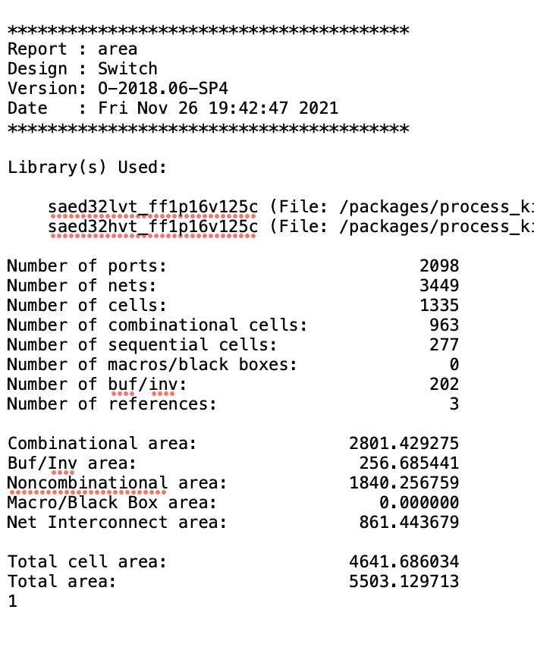
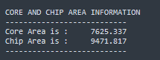
Area report
Before Physical Design
After Physical design

Slide 29
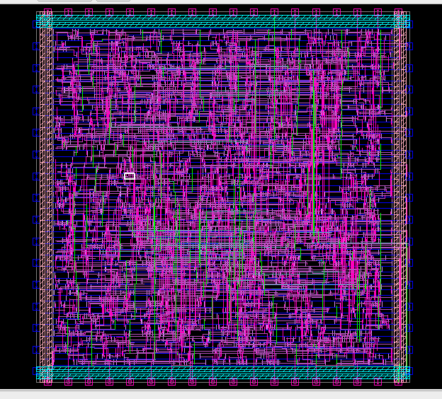
Extraction
Physical die
With a few hundred thousand dollars we can fabricate this chip

Slide 30
Some Challenges and Learnings
We Learnt how to work in the Synopsys EDA environment using the UNIX workspace
Specific Libraries are called based on Design Specification
To change the clock after Doing Physical Design is a waste of engineering resources. Hence STA is performed after Design Synthesis.
Many ways can be employed to provide data from memory to the Design; We called .hex files in the testbench.

Slide 31
References
We studied the concepts from various IEEE research papers and other documents from the Necrl lab.

